Slide 1

@rmchase
Fear & Optimism
about
Our Future

Slide 2
I’ve been deeply worried
about the implications of
CLIMATE CHANGE
and
AUTONOMOUS VEHICLES

Slide 3
Scientists tell us we will be +5-6C with BAU
Globally: is this year hotter or colder than 20th C average?

Slide 4
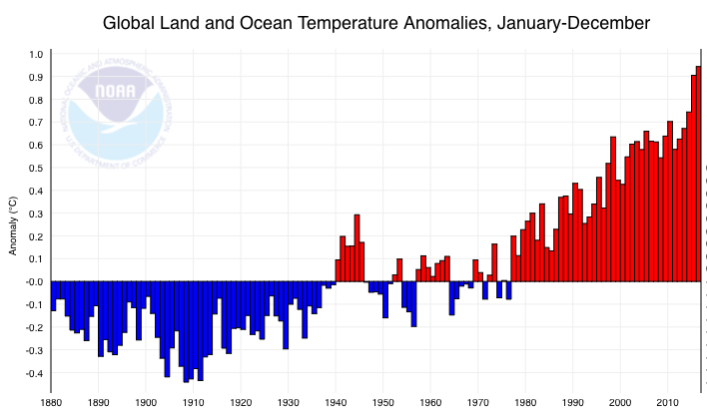
Scientists tell us we will be +5-6C with BAU
Scientists predict +5-6C by 2100 under BAU
Globally: is this year hotter or colder than 20th C average?
2017
+1C
2016
2015

Slide 5

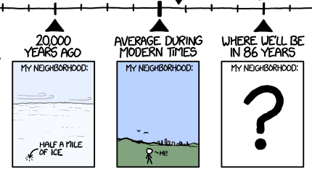
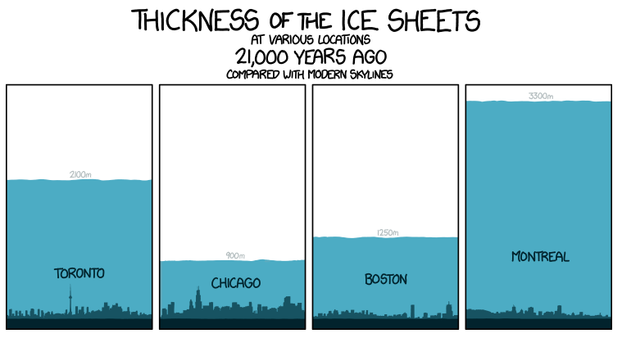
-
+
Credit: Randall Monroe

Slide 6
“The infrastructure we build over the next 3 years will determine the fate of humanity.”
--Christiana Figueres

Slide 7
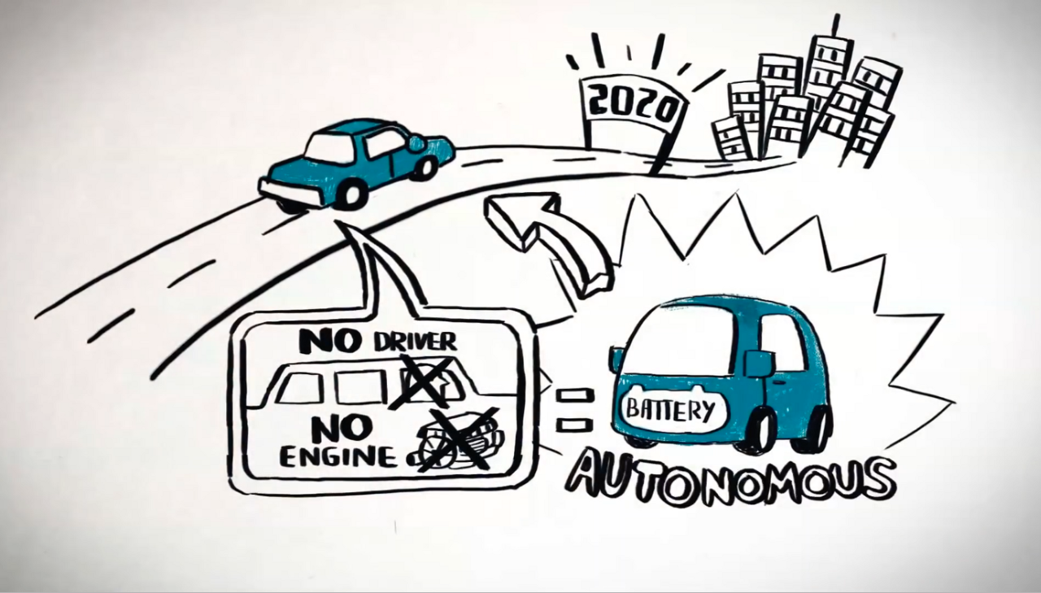
https://www.youtube.com/watch?v=UcCD3lXYlTk

Slide 8
“It’s irrelevant to my city”
“It won’t happen in my city for decades.”
“Pilots are happening in my city
right now”

Slide 9

We get to
AV HEAVEN

Slide 10
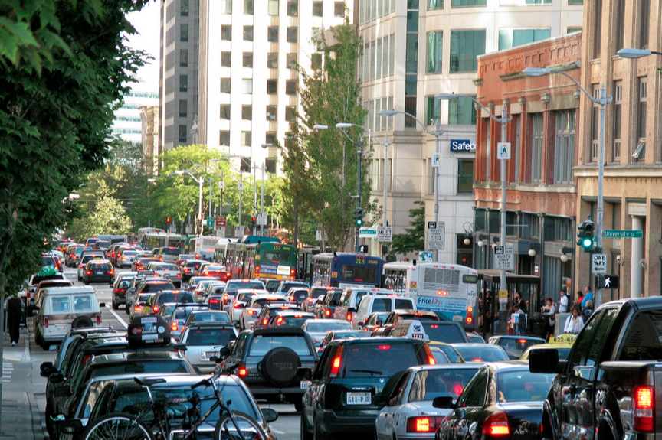
By fixing NOW the problems
that have us currently living in
transport HELL

Slide 11


Slide 12
4/10 points:
Transition to zero emission
Encourage efficient use of space and assets
Seek fair user fees across all modes
Deliver public benefits via open data

Slide 13
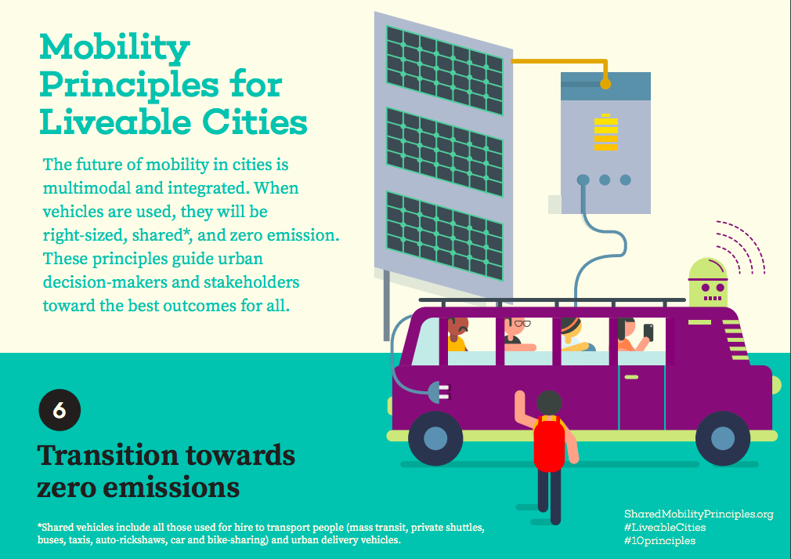
Start with intensively used vehicles!
Buses
Taxis
Utility
Delivery
Have goals for all vehicles
W
When AVs arrive,
shared ones would have to be ZEV; maybe personal ones too.
POLLUTED AIR: 7 million premature deaths per year,
50% linked to transport

Slide 14
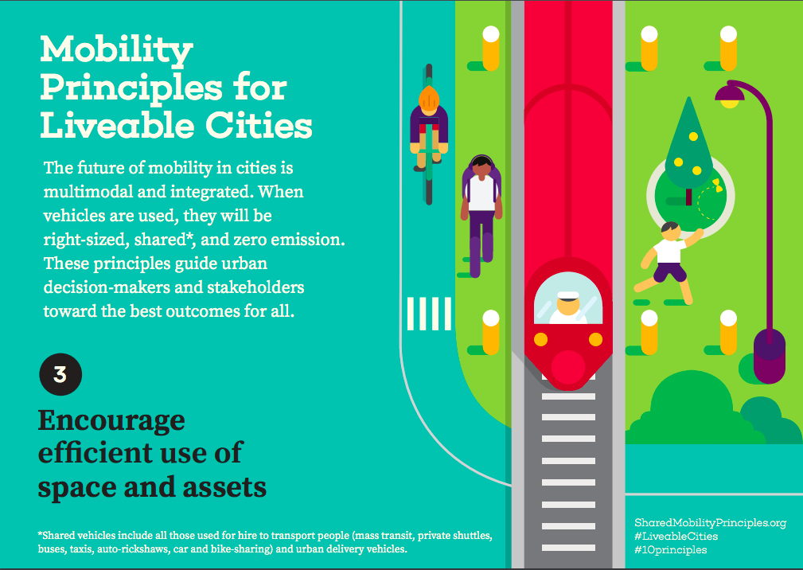
ROAD CRASHES: 1.2 million deaths per year

Slide 15
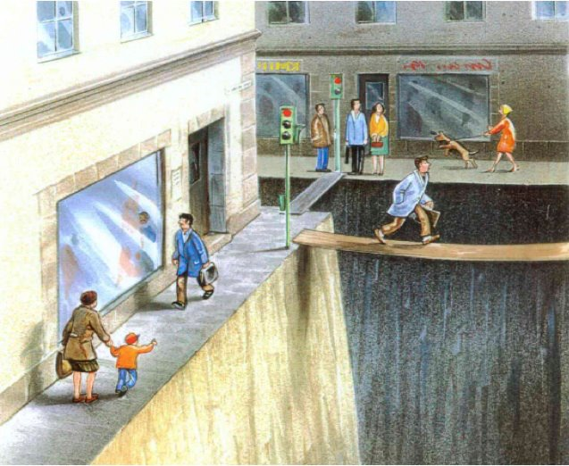
OBESITY linked to LACK OF PHYSICAL ACTIVITY: 2.8m adult deaths per year
Karl Jilg

Slide 16
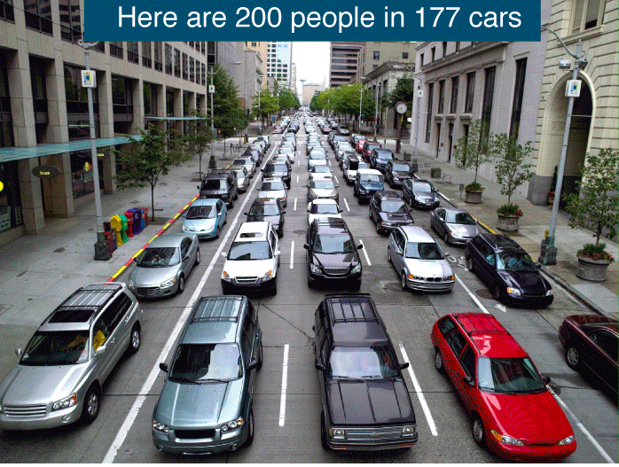
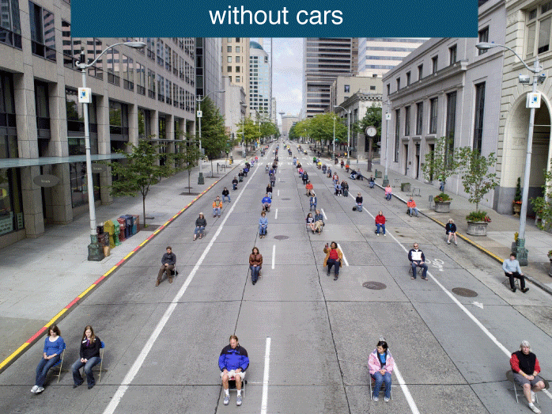

Slide 17
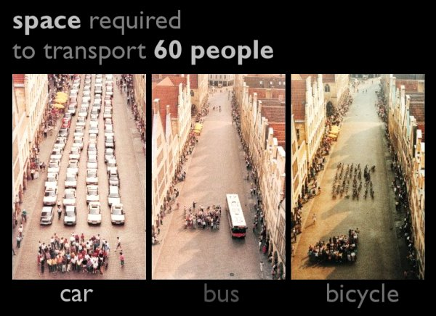

Slide 18
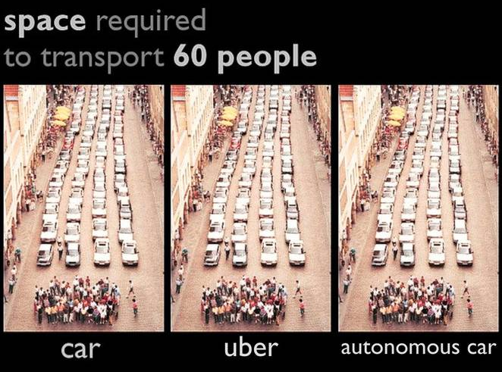

Slide 19
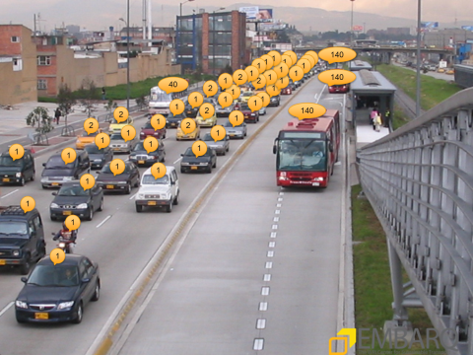
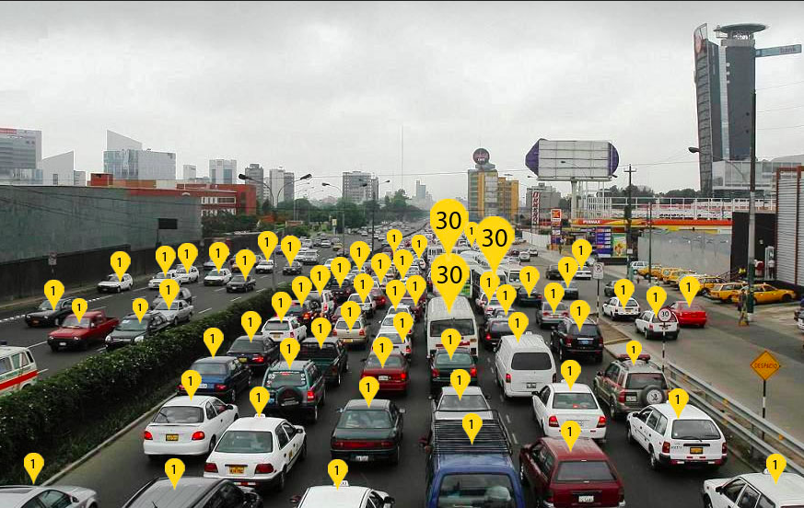
(inefficient) USE OF SPACE TODAY

Slide 20
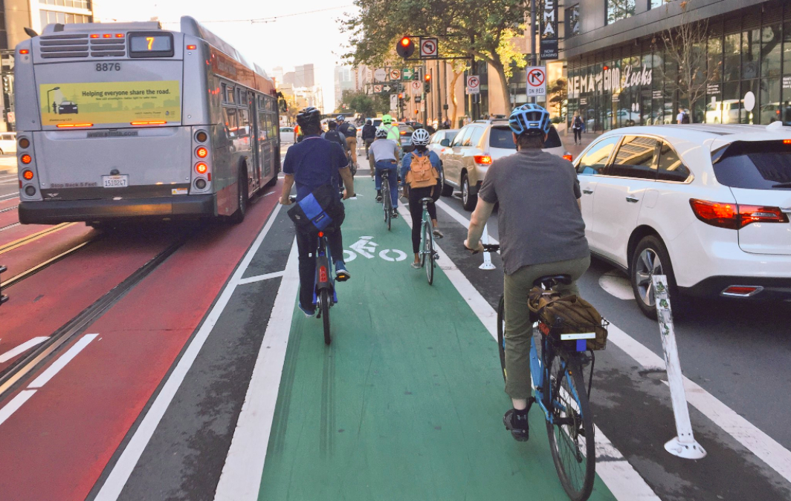
MAKING SPACE FOR EFFICIENT MODES WITH LANE ALLOCATION
SHARED TRANSPORT CYCLE PRIVATE CARS
50 people by 🚌 20 people by 🚲 6 people by 🚗.
When AVs arrive,
If they are SOV,
they will travel here.

Slide 21
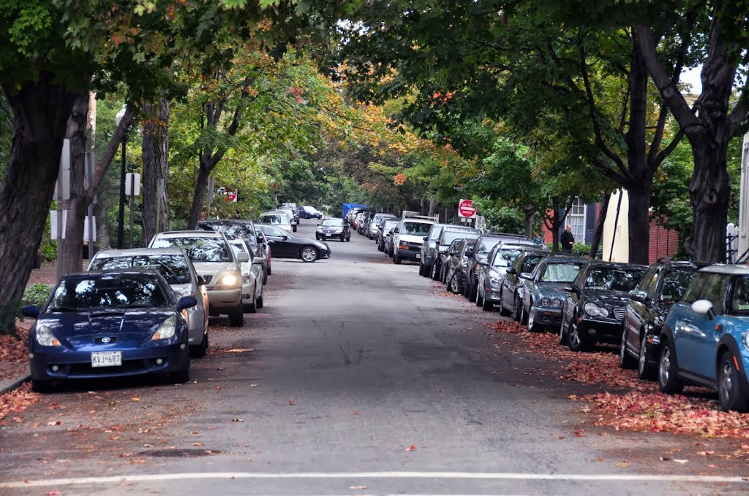
(inefficient) USE OF CARS

Slide 22
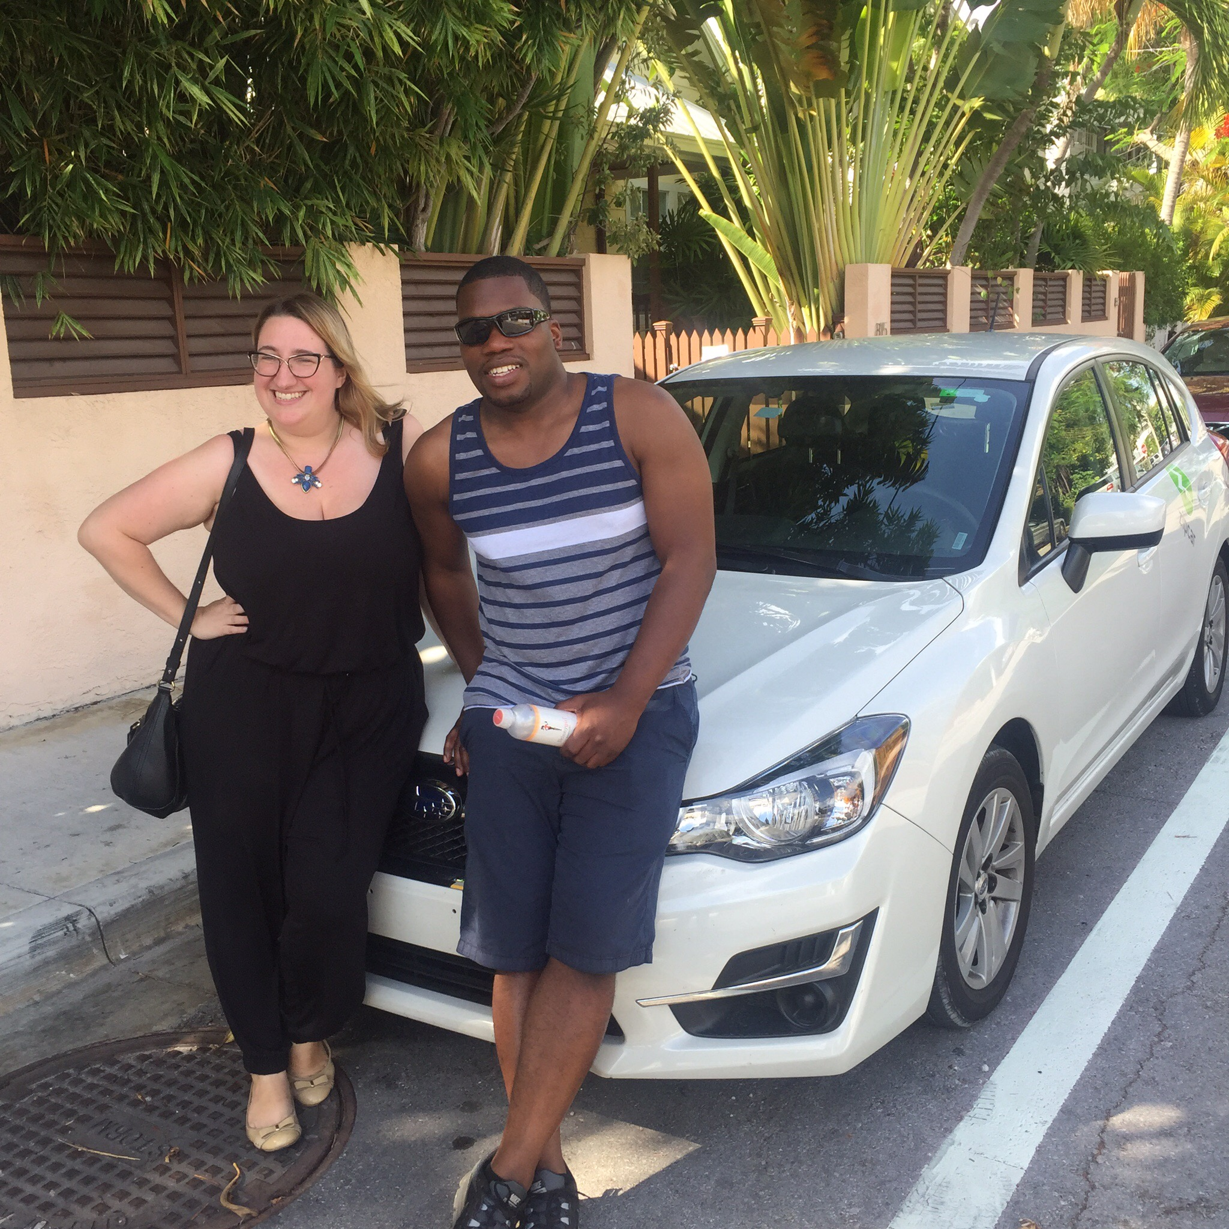
Zipcar’s breakthrough:
undeniable proof that
SHARING WORKS
Is welcomed by mainstream city dwellers
A viable business model
Produces real CO2 reductions (& other city benefits)
Is simple thanks to tech

Slide 23
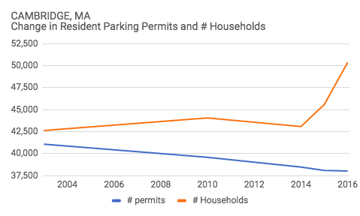
Zipcar: 1 million people sharing 13,000 cars around the world,
Each car replaces 13 personally owned cars
(Removing 1 729 000 cars from cities!)
In Cambridge MA:
25% of Cambridge residents are members!
~200 zipcars
~2600 fewer cars!
2003-2016 a 22% decrease
in parking registrations per household

Slide 24
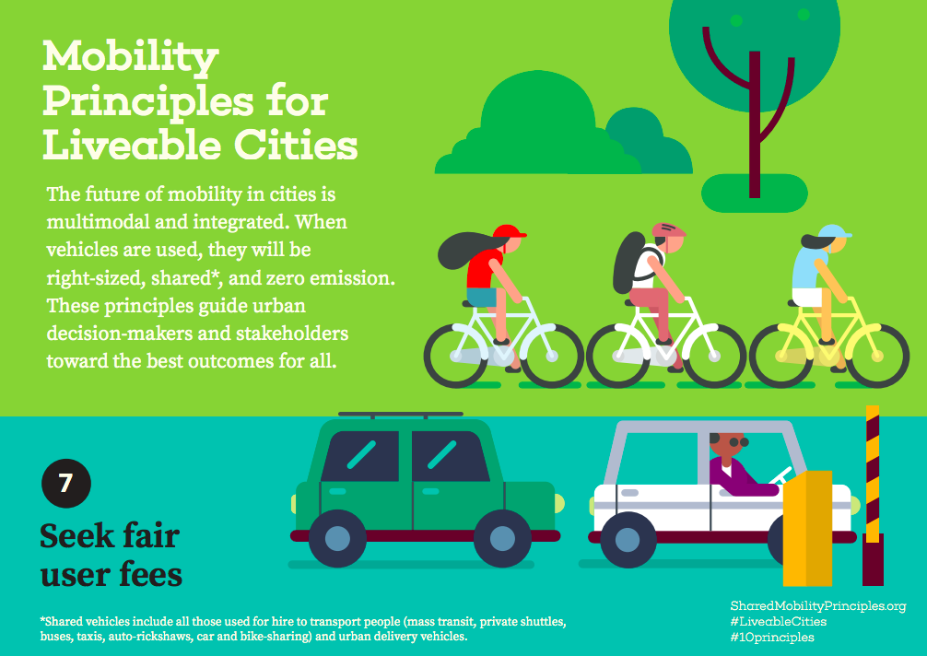
TODAY: Weak wrong unfair pricing
Road User Fees that cover costs!
Honest Parking (curb access) fees
Pollution/Air Quality fees
Congestion Pricing
  Per square meter?!

Slide 25
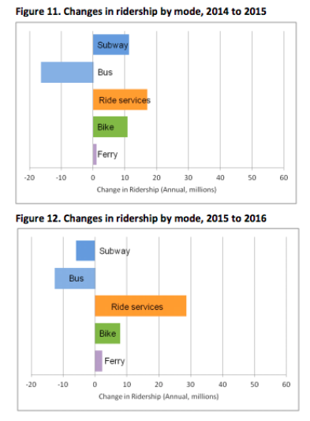
An analysis of New York City
e-hailing (TNC) data
net increases of 31 million trips and 52 million passengers over the past 3 years
• the addition of 600 million miles of vehicular travel over the past 3 years (+7%!)
increased congestion

Slide 26
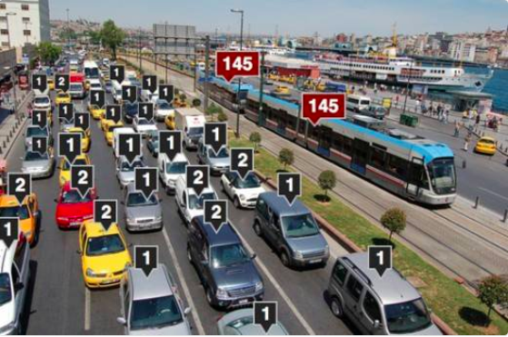
FAIR USER FEES
ACROSS ALL MODES
And to use congestion pricing revenue
to improve sustainable transit modes
Solution is NOT
to tax or ban
e-hailing or taxis
surge pricing IS congestion pricing
With revenues going to company rather than government!

Slide 27
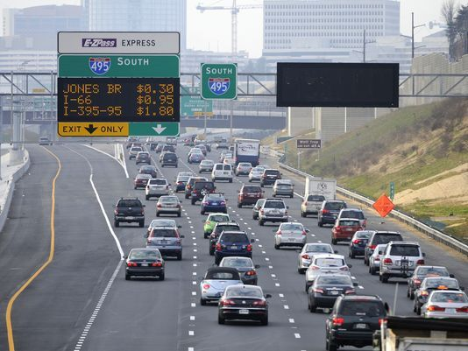
HOV lanes with
dynamic pricing (Lexus) lanes (!)
Urban HOV3+ lanes & paid

Slide 28
Road User Fees that cover costs!
Honest Parking (curb access) fees
Pollution/Air Quality fees
Congestion Pricing
  Per square meter?!
When AVs come,
When AVs come,
We will already be getting revenue from pickup, dropoff, delivery curb management fees, so loss of parking fees won’t bankrupt us.
When AVs come,
Well-priced congestion pricing will disincentivise Zombie cars (zero occupancy)

Slide 29
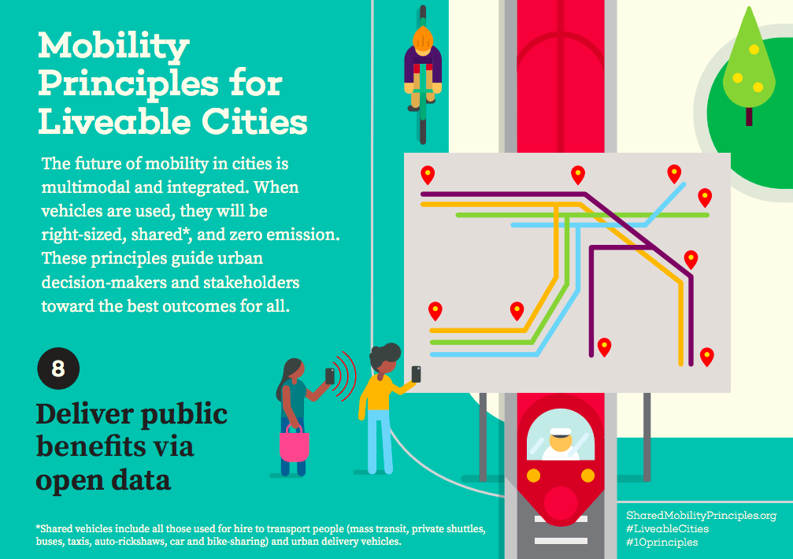

Slide 30




Transportation networks tend toward monopoly
Monopolies (even regulated ones) innovate little.
Global monopolies exclude local & startup companies

Slide 31
Ensure Competition & Interoperability
We must demand the use of Standard Open Data
for Shared Rides (see OTP.org),
and Metros & Buses (GTFS).

Slide 32
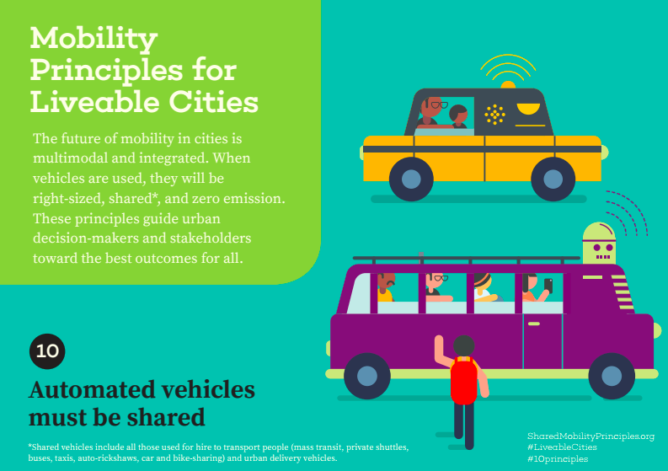
If we follow rules 1-9,
ELECTRIC + SHARED + AUTOMOUS will happen naturally.
If we fail to execute perfectly this rule #10 will still make it happen
No matter when AVs arrive, we will have made our cities better!

Slide 33
INFRASTRUCTURE
IS
DESTINY
EXCLUSION: roughly 1 in 6 people (1.3 billion) remain in extreme poverty

Slide 34
LET’S CREATE THE WORLD WE WANT TO LIVE IN
SharedMobilityPrinciples.org

Slide 35
LET’S CREATE THE WORLD WE WANT TO LIVE IN
can
SharedMobilityPrinciples.org

